Slide 1
Please note that today’s AGM and Conference business is being livestreamed online. If you are presenting, speaking from the floor or asking questions during sessions, you will appear on the livestream.

Slide 2
Please find time this weekend to raise a glass to the dedicated CAMRA members that we have lost in the last year

Slide 3
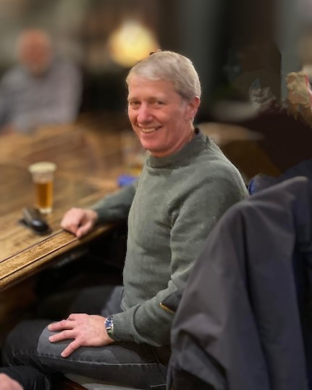
Bill Barnes Weston-super-Mare
During March 2024, it was with great sadness that the Weston-super-Mare branch of CAMRA received news from his family that Bill had passed away after a short illness.
Bill, a keen cyclist, first became involved with the branch following the family’s move from Plymouth, where he’d previously been the CAMRA branch membership secretary.
Reluctant at first to take a leading role after joining us in early 2014, he finally offered to take the position of inaugural branch chairman, subsequently shouldering an increasing number of roles and responsibilities from then on. By doing so, he was unknowingly keeping the flagging branch afloat.
Additionally, Bill later took on the responsibility for coordination and submission of the branch’s annual Good Beer Guide selections.
He managed to maintain all his duties throughout the duration of his illness, until eventually having no alternative but to stand down when finally unable to continue any longer.
It's no understatement to reiterate that without Bill's commitment, the branch may well have folded.
His contribution to the Weston-super-Mare branch, and especially his genial approach to all areas of his responsibilities was much appreciated by all who knew him, and he’ll be greatly missed.

Slide 4
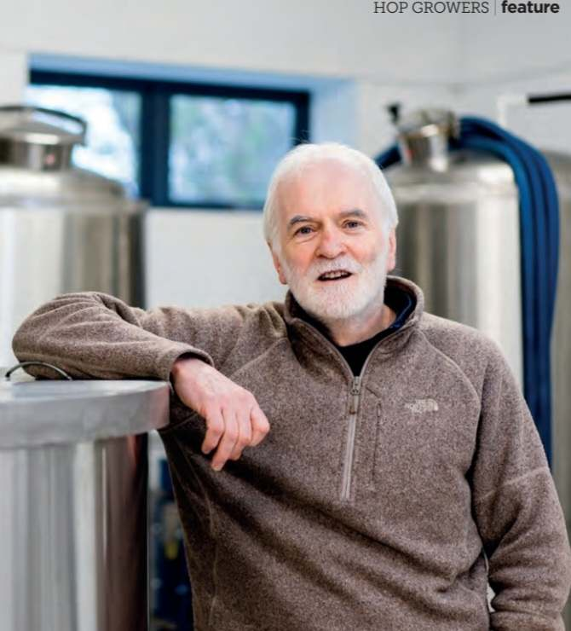
Charles Ballantyne Northern Ireland
Charles was a real ale advocate who had a feature written about him in BEER magazine Summer 2022. He was the owner and brewer of Ards Brewery from its inception in 2011.

Slide 5
Moray Taylor York
Moray Taylor died on Friday 8th November, aged only 56, after a prolonged period of ill health.
Moray was a dedicated fan of U2, which I had trouble understanding, and remember teasing him about his musical tastes. He supported York City FC, who are having a good season, albeit in the 5th tier National League. He was also a dedicated walker and completed the “coast to coast” with his friends, who nicknamed him “Dr Moz”. Moray was very well educated and gained his doctorate whilst working for the Ministry of Agriculture at the Rothamsted Research Centre in Harpenden. He joined South Herts CAMRA, was active in the branch, and co-edited Pints of View with Watford & District’s Bill Austin. This lasted for about three years until summer 1996 when his job relocated to the Central Science Laboratory in York.
However, despite the move North, Moray kept in regular contact with the South Herts branch members, both at the St Albans Beer & Cider Festival, where he volunteered, and at CAMRA national AGMs. He attended every one from 1993 in Salford through to last year in Dundee.
Quite an achievement that involved a lot of travelling. During the early years he shared rooms with Steve Bury in what Steve remembers as some of the most awful and eccentric B&Bs around the country! Whilst Moray was a quiet and reserved person, he held strong beliefs regarding pubs, beer and breweries. Steve will certainly miss him and is sure will many of his friends and colleagues will too.

Slide 6
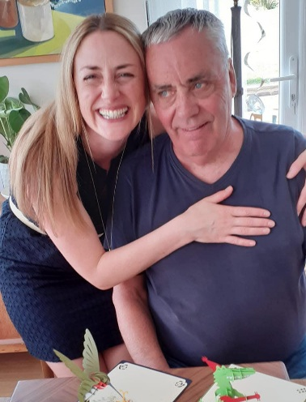
Jim Elsam Brighton and South Downs
Jim was a much-loved family man and active member of the Ringmer village community. A lover of Havey's Sussex Best he loved to pop into his local - The Anchor - for a pint.
Jim stepped up as a volunteer to help our branch, acting as our Secretary for two years (2023 and 24) until his illness prevented his participation further.

Slide 7
Julian Clark Gainsborough
Julian was a member from 1995, one of many people who were seduced by the fantastic beers that the late Alex Craig offered at the Eight Jolly Brewers in Gainsborough. He was a committee member for a number of years and had a thing about malt loaf with the addition of a stout, which he would bring along on Sunday lunchtime. He was diagnosed with prostate cancer about eight years ago and was given three to five years. His indomitable spirit and extremely positive outlook saw him add three years to the upper estimate.

Slide 8
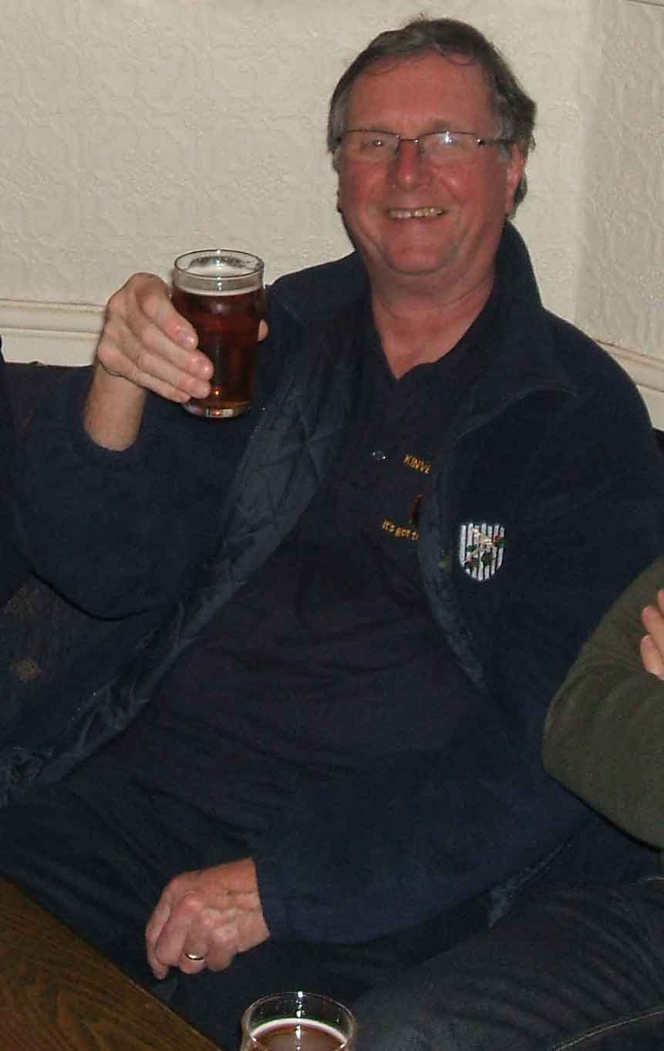
Trevor Hyde Redditch and Bromsgrove
Trevor Hyde passed away peacefully in October 2024 after a short illness. Based in Bromsgrove (Worcestershire), Trevor served on Redditch & Bromsgrove CAMRA branch’s committee as treasurer and was also the treasurer of both Bromsgrove and Redditch Beer Festivals, assisting with sponsorship and making sure that the festivals stayed on track. He was a loyal, witty and passionate member of CAMRA who was known at both branch and regional levels. He had a love of dark beer and was a big fan of West Bromwich Albion.
Trevor also volunteered for the campaign at a regional level as West Midlands Regional Finance Officer assisting branches with beer festival proposal plans. He also had an active interest in the Worcester-Birmingham & Droitwich Canal Society and volunteered on their committee as treasurer.

Slide 9
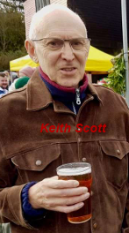
Keith Scott Exeter and East Devon
A life member who joined CAMRA in 1992. He attended beer festivals all over the UK with his wife, Rose, and was last seen on a CAMRA outing at last year’s branch Christmas Tom Cobley meal. His favourite beer was from Yates (a Cumbrian brewery – now closed) but he recently had a pint of Teignworthy ‘Thirsty Blonde’ and wrote in his diary “Yates’ish”.

Slide 10
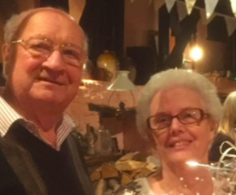
Rowland & Thelma Honeywill Exeter and East Devon
Thelma was always immaculately dressed whilst Rowland typically sported a dashing waistcoat. They were married in 1958 and were active and enthusiastic branch members and supporters of real ale (a particular favourite of Thelma’s being Dartmoor Brewery Jail Ale). They ran The Wild Goose at Combeinteignhead (South Devon branch) for many years with an excellent beer selection and home-cooked food. When they retired, Thelma and Rowland returned to Exeter and became involved in the Exeter and East Devon branch. Rowland was Treasurer between 2007 and 2012 whilst Thelma was Press Officer plus BLO for Warrior Brewery. They were also members of the Crash Box Motor Club Exeter and helped organise a small beer festival at Powderham Castle each year. They both loved traditional jazz often attending venues in and around Exeter.

Slide 11
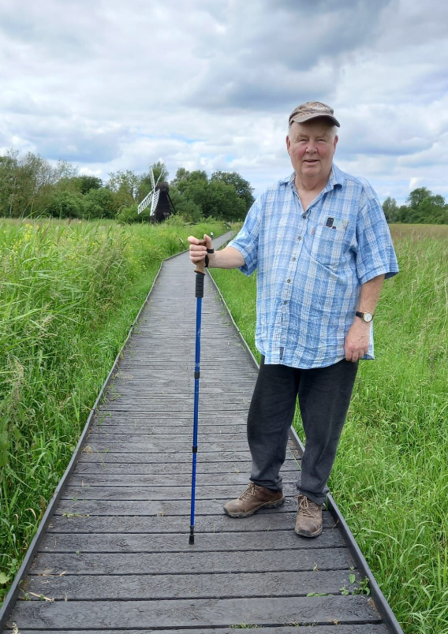
Eryl Morris Gwynedd a Mon
Eryl was Chair of the Gwynedd a Mon Branch for almost two decades. His commitment to promoting real ale led to him being the driving force of the Cwrw a'r Cledrau beer festival held at the Welsh Highland Railway - it won’t be the same without him.

Slide 12
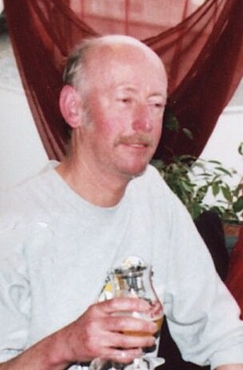
Clive Taylor Kingston and Leatherhead
Clive Taylor, a stalwart of Kingston & Leatherhead branch and a regular participant in Members’ Weekends, died in June 2024 after a period of deteriorating health. Over 32 years Clive made an outstanding contribution to the branch in his committee roles as Membership and Social Secretary. He also manned the Membership and Product stands at the Kingston and Woking Beer Festivals, recruiting dozens of new members over the years as well as providing valuable assistance with set up, takedown and festival organisation. He wrote regular articles for local branch magazines and as a keen photographer he gathered an impressive collection of pub photos, some of which can now be viewed on the branch website.
He is sorely missed.

Slide 13
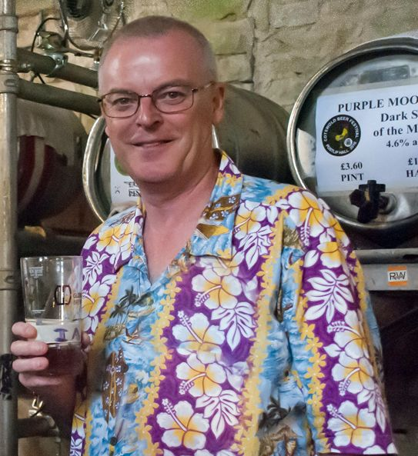
Ian Scott Cheltenham
Originating from Plymouth before moving to Cheltenham; Ian was an active member of the Cheltenham branch committee and the sub-branch committee before that. He held many roles over the years including secretary and newsletter edition. He was also involved in the organisation of both Cotswold Beer Festival and the Cheltenham Real Ale Festival, and was an active helper at the North Cotswold Beer festival.

Slide 14
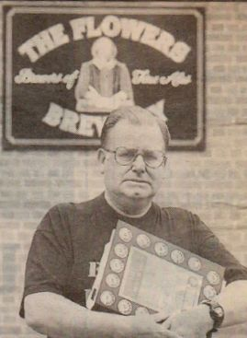
Tony Aburrow Cheltenham
Tony was a long time member of CAMRA and Chairman of the Gloucestershire branch for many years in the 1990s and early 2000s.
Tony was a tireless campaigner for the Gloucestershire branch and was heavily involved in the campaign in the late 1990s to try and save Whitbread Flowers brewery in Cheltenham.

Slide 15
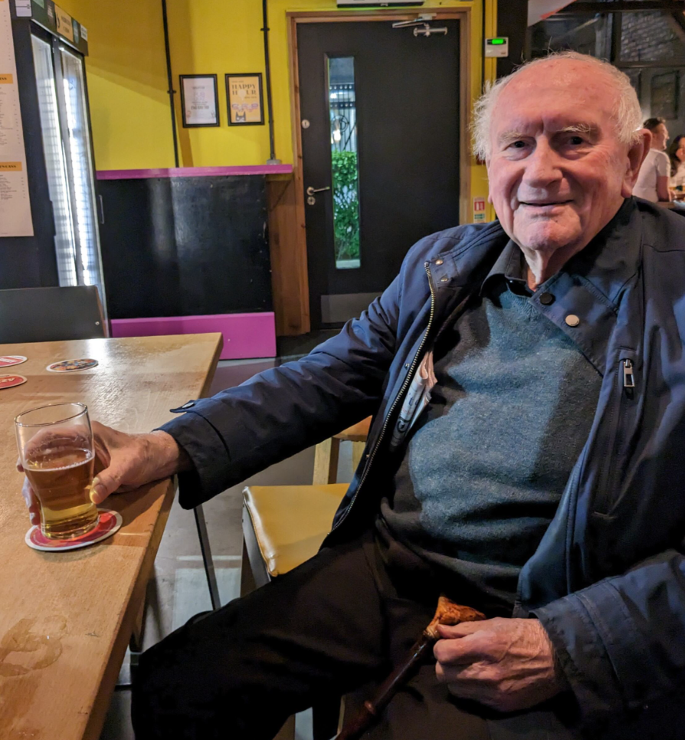
Neil Kellett Stockport and South Manchester
Neil was a founding member of the branch in January 1974 and continued to be active as a social member until his death at the age of 85 in December 2024.
An accountant by profession, Neil acted as CAMRA's auditor for many years and was also a founder of the CAMRA Members Investment Club. In between his CAMRA activities, he was a constant traveller in search of good beer, and good cricket - his meticulous arrangements on his many trips became the stuff of legend.
He was also a frequent participant on many Podge Tours to Belgium. In his later years he was definitely something of a bon viveur, and while we mourned his passing, we also looked back on a life very well lived.

Slide 16
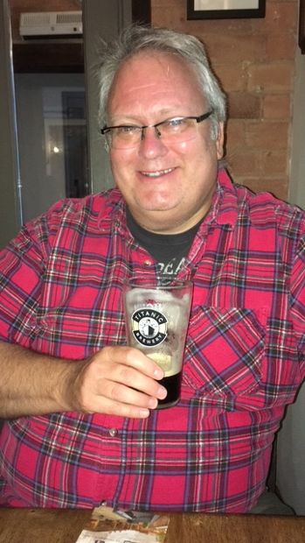
Nick Molyneux Nottingham
Nick passed away suddenly on 24th October. Our condolences go to his partner, Carrie, and family.
Nick was a former member of the Nottingham CAMRA committee and after standing back from that role remained as our Pub Conservation officer. He was a passionate campaigner for the protection of our pubs and worked tirelessly to ensure that many pubs were protected by a designation of assets of community value (ACVs).
In 2019 he became the first recipient of the Nottingham Campaigner of the Year award “for his work on ACVs and for vigorous campaigning on conservation”.
Most recently Nick was heavily involved in the successful efforts to rescue the Old General Statue that had stood above the door of the pub of that name in Hyson Green. It can now be viewed at the Vat and Fiddle.

Slide 17
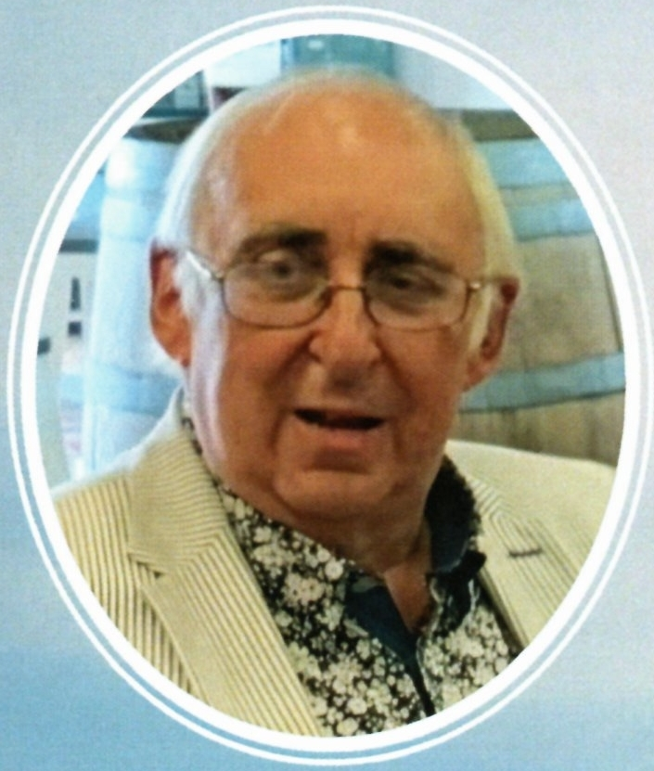
Richard Andrew Sanders Loughborough and North Leicestershire
Richard (The Colonel) Sanders was the first chairman of the Loughborough branch of CAMRA. The first meeting was held on 14th November 1974 at the Griffin in Ashby Square, and the first committee meeting held soon after at the Peacock. Richard was the chairman at this meeting.
Richard soon became involved in CAMRA at a national level and worked with many of the original founding members. He was still active within the local CAMRA branch until his death, being the Brewery Liaison Officer for the local Charnwood Brewery.

Slide 18
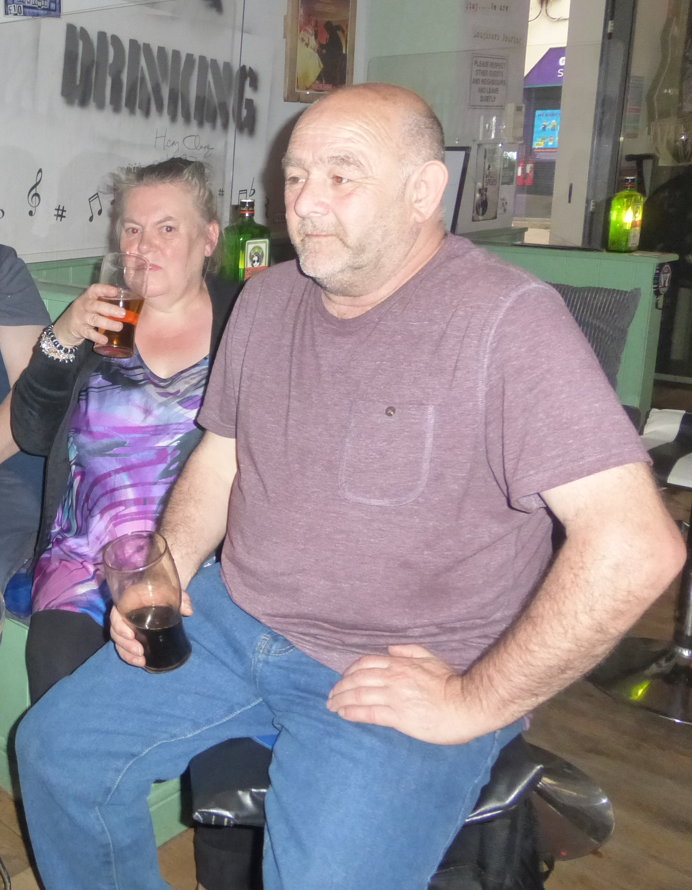
Terry Taroni Loughborough and North Leicestershire
Terry was a stalwart of the branch for many years. Many visiting our beer festivals will have seen Terry behind the bar or in the kitchen where he excelled at flipping burgers. Short in stature but with a big heart and an even bigger grin, Terry was a hard worker, only occasionally moaning about the amount of beers requested from “the top shelf”, knowing he couldn’t reach them!
Terry enjoyed his CAMRA trips with the branch even if he sometimes questioned where he was getting off trains and whether the bus would turn up, often to be heard saying “Don’t Believe Ya!” when told a bus was due. He was often joined by wife, Jean, and best mate Grinning John who did their best to make sure he got home ok.
Terry unfortunately died just before Christmas and many of the branch joined Jean and their sons Shaun and Martin to celebrate his life in a way Terry would have approved of, by consuming a few pints at the Moonface Brewery Tap where Terry was well known.

Slide 19
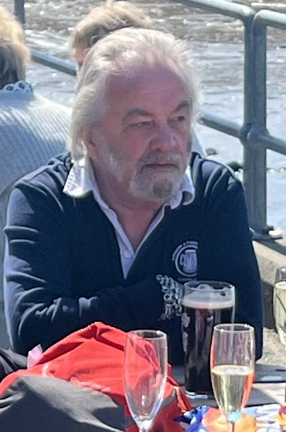
Bobby Shaw Ayrshire and Wigtownshire
Bobby's funeral took place on 12th February after a fairly short illness. He lived in Kilbirnie, Ayrshire and was an enthusiastic CAMRA member, often assisting at the Ayrshire Real Ale Festival, as well as supporting the Garnock Valley Social Club when they introduced real ale and beer festivals a number of years back. Bobby also had a love of motorbikes, cars and cigars and will be greatly missed by his wife Ellen and family.

Slide 20
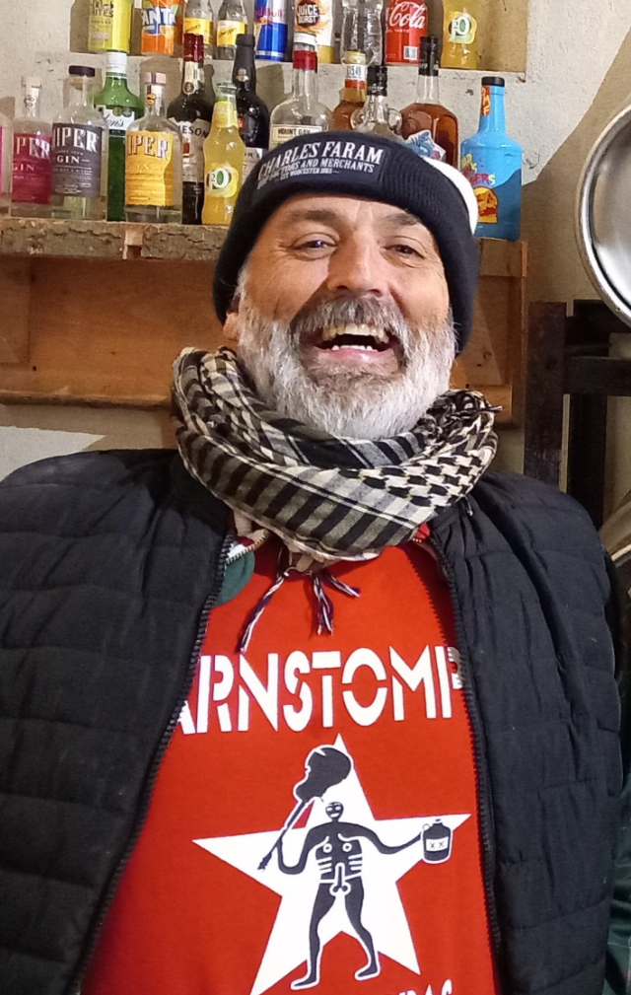
Victor Irvine West Dorset
The West Dorset branch of CAMRA are deeply saddened to give notice of the death of Victor Irvine (Vic) of Cerne Abbas the co-founder of the Cerne Abbas brewery aged 54.
Vic grew up in the Ascot area where his parents owned a flooring shop. He kept in touch with school friends in particular the singer/songwriter Chesney Hawkes who would go on to actively raise money and dedicate his last single to Vic. Vic was also a massive West Ham fan and appeared on stage in Prague with Chesney prior to them winning the UEFA Europa Conference league final in 2023.
In 2008 Vic and wife Maddy relocated to Dorset and in 2009 they bought the Old Mill House in Cerne Abbas and quickly integrated into village life. On leaving the flooring business Vic ran a skateboard shop in Weymouth, though not a profitable venture, Vic loved the freedom to skate. Between all of this Vic started to read about the history of Cerne Abbas and in particular its historical association with beer, somebody said to Vic, “If you enjoy what you do then you never work a day in your life” to which Vic thought “what do I enjoy, beer”!
In 2011 Vic had successfully been appointed “Head Brewer” at the nearby Piddle brewery, a position acquired more by luck and chance than any brewing qualification. Vic was always tweaking and adjusting the brewery recipes as he was a perfectionist. From day one of brewing he would always maintain “clean, clean, and clean”.

Slide 21
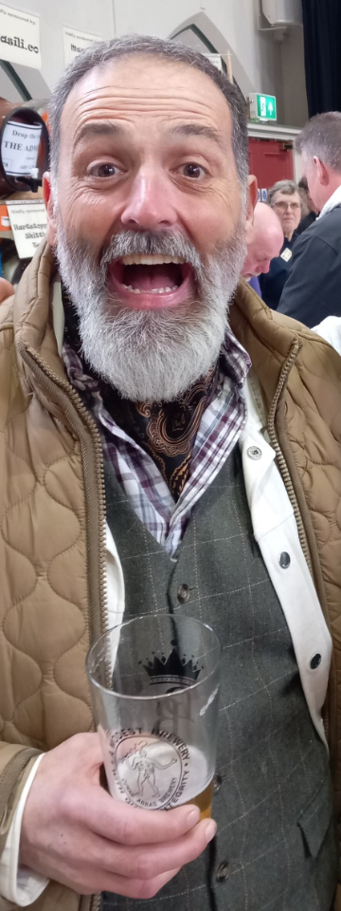
Victor Irvine West Dorset (continued)
Local Cerne Abbas resident Jodie Moore of the Giant Inn pub in Cerne Abbas and friend of Vic’s had had a domestic falling out with his partner and needed to work elsewhere, and over a pint one night they decided to start a brewery. Though at this point cider was the idea, it was far from the best so plans as cider makers were put on hold. At the same time the Artbrew brewery was put up for sale in North Chideock and Vic and Jodie leapt at the chance to buy it. So in 2014 the Cerne Abbas brewery produced its first beers in North Chideock.
CAMRA “Beer of the Festival” awards started to appear from day one of the brewery, winning Gold at Weymouth in 2014 with Cerne Ale and again in 2016 with Gurt Coconuts Rum stout alongside numerous awards at other festivals including many at Dorchester Beerex, but what is most unusual is in 2023 taking the top three spots at Dorchester Beerex with Mrs Vales Ale, Danny’s Brew and Gurt Vanilla Stout. One of Vic’s main objectives was getting brewing back to the heart of Cerne Abbas; the first move was around 2016 when the brewery relocated to Black Hill Barn amongst the high hills that surround Cerne Abbas. The brewery now resides at Chescombe barn on Barton Meadows farm, Cerne Abbas.
Everything was going so well for Vic and Jodie, the brewery had established a tap room, music festivals were being held then tragically in June 2021 Vic was diagnosed with stage 4 lung cancer, a condition that was to be terminal. Vic being upbeat and positive didn’t want the disease to beat him; he was given three years to live and fought the disease for four years before being taken far too soon. Vic used to say “take more chances, dance more dances”. He leaves a loving family, Maddy his devoted wife and children Sam, Archie and Mabelle. His funeral took place in February where an estimated 700 people packed the church, streets and three pubs to watch a heart wrenching service, but even then Vic had the last laugh as in the middle of wife Maddy’s eulogy a recording of Vic interrupted the service with a knock of the coffin “Hurry up its dark in here”! Humour and laughs to the last. Vic is buried in Cerne Abbas graveyard now at finally at peace.

Slide 22
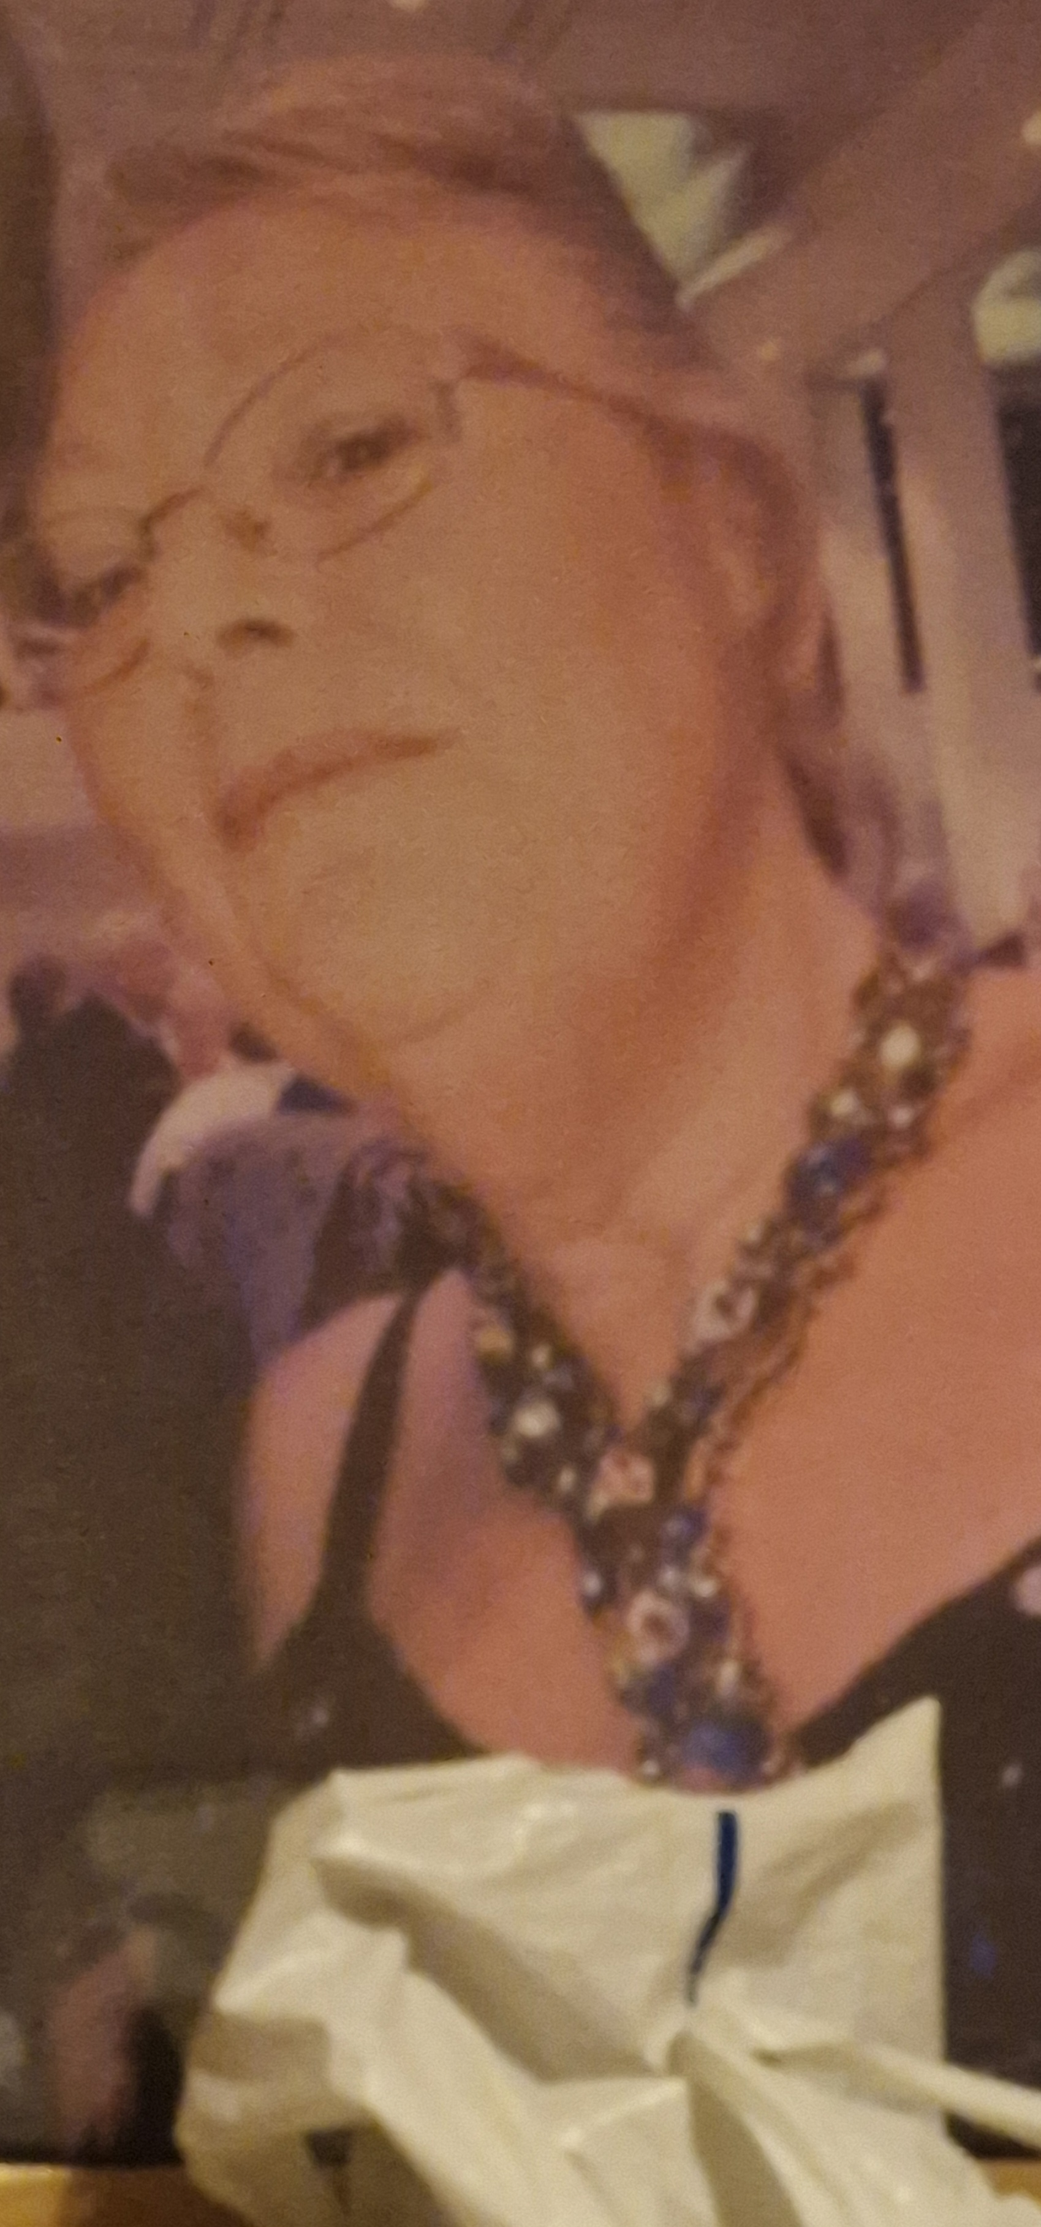
Elspeth Brady Bradford
Elspeth was involved many festivals. At some festivals she worked on the cider bar, and at GBBF she was the deputy manager in the family room. She obtained her SIA licence and was active in the Stewarding team. With her first aid qualification she became part of the CAMRA first aid team. It varied which shirt she wore at different festivals.

Slide 23
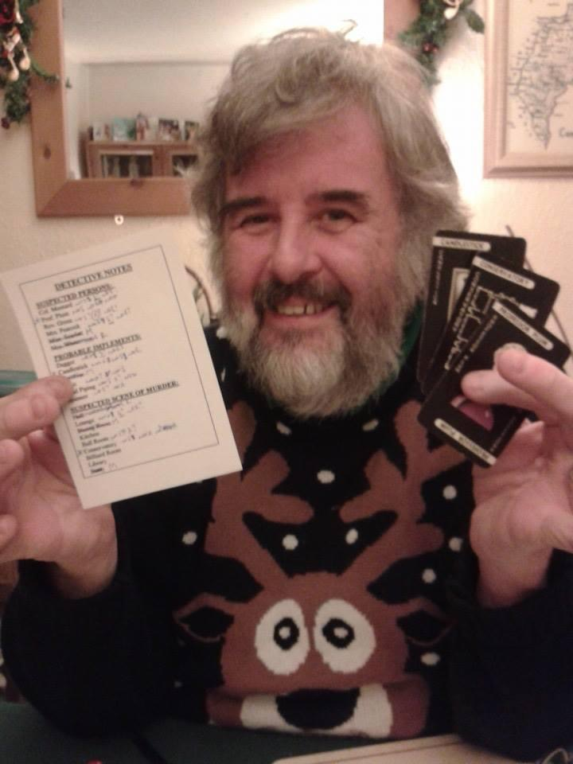
Malcolm Harding Rugby
Malcolm died suddenly in October 2024. He was a member of the Rugby branch and was also once employed by CAMRA as their Chief Finance Officer at the St Albans HQ.
Malcolm was a lovely bloke, who was extremely knowledgeable and respected across the CAMRA world. He always had time for people and was always kind and courteous. A true gentleman. Tributes have been pouring in from those who knew him. Over the years he did everything to support the cause of real ale, from ordering the beers for the Great British Beer Festival to helping start the Merchants Inn in town. Malcolm was very proud of the fact that he had a CAMRA membership number of 3. His work was rewarded recently when he was awarded the prestigious CAMRA Campaigner of the Year award.
Outside his work with CAMRA, Malcolm was a huge football fan. He was a season ticket holder at Spurs, but also liked watching any game no matter what size. He was also very keen on cricket and it was appropriate that his last match was watching Warwickshire play Essex at Edgbaston. He was a man of great faith who helped run Bible classes, and was a member of Coventry and District chess league.
Sue, his wife of over 40 years, has said, “Some people when they go leave a hole. Malcolm has left a massive crater.” This is certainly true. He last joined the branch on the night of the Country Pub of the Year award at the Admiral Nelson in Braunston. Little did we know that would be last time we had the pleasure of his company. Malcolm leaves his wife Sue and children Rachel and Andy. Our love goes out to them at this difficult time.

Slide 24
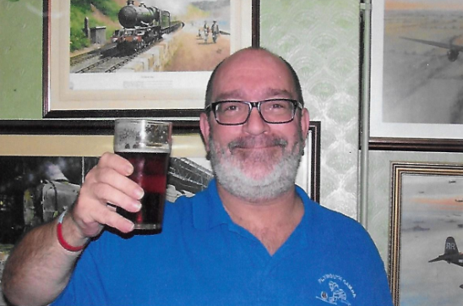
Ian “Dickie” Dickinson Plymouth
Ian passed away in June 2024, he was an active member with CAMRA for over 30 years serving most of that time with Plymouth CAMRA branch. He also was South West regional Brewery Liaison Coordinator for several years. In his time with Plymouth CAMRA, he held several positions and at the time of his death, he was Webmaster, NBBS coordinator, Vice Chair, WhatPub editor amongst other voluntary tasks. "Dickie" spent over 22 years in the Royal Navy and was from the Oakham, Leicestershire area. A keen Rugby fan, he followed the Leicester Tigers and in later years Plymouth Albion. He also loved football and was a Foxes fan (Leicester City).

Slide 25
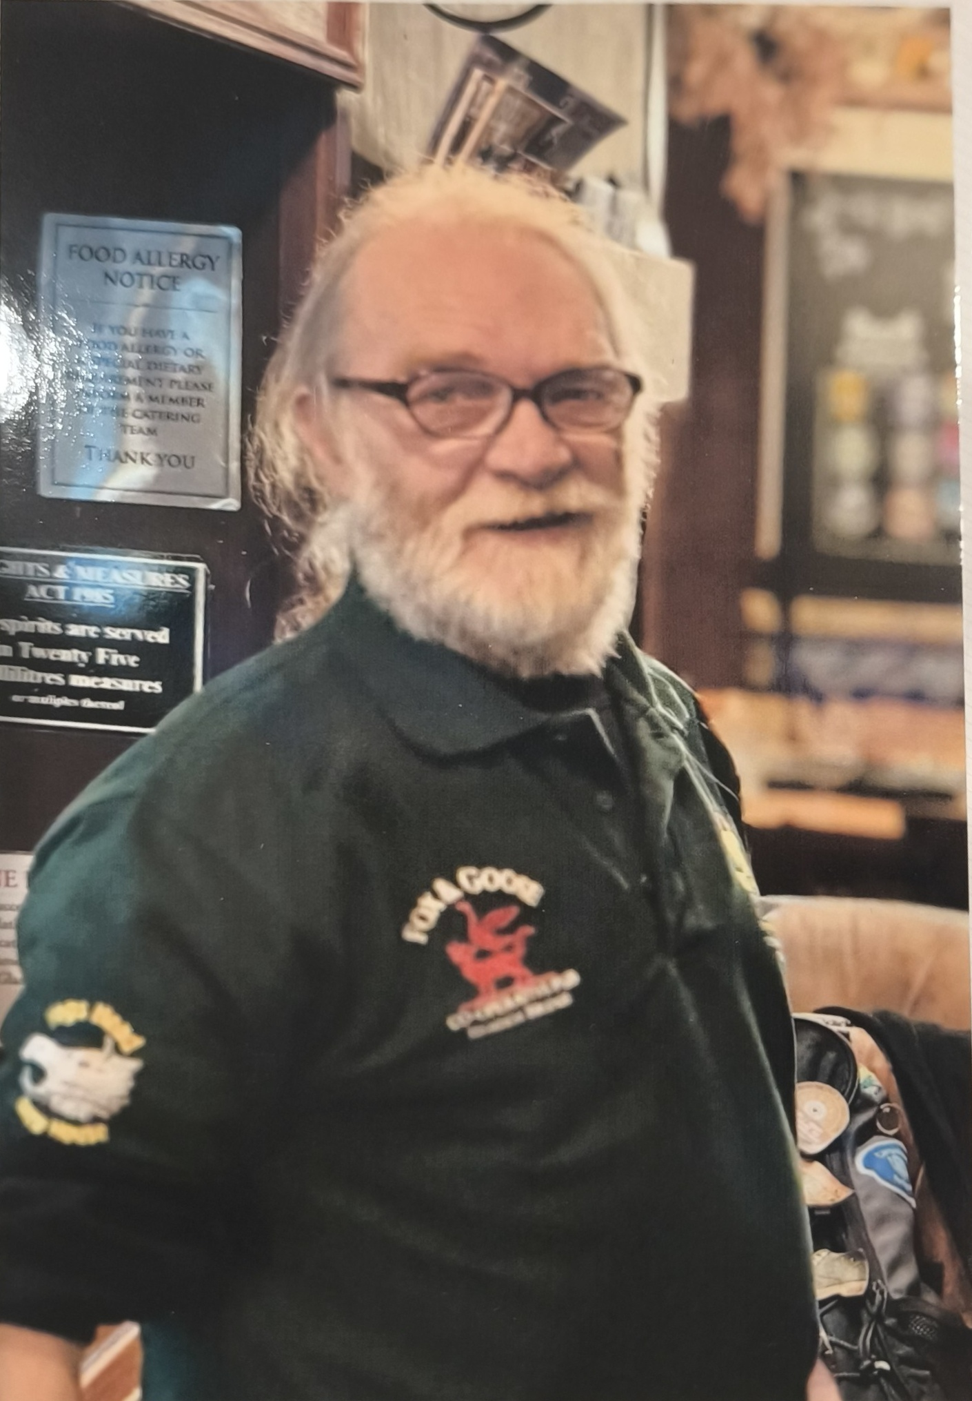
John Hartley Halifax and Calderdale
The Halifax & Calderdale Branch are devastated to announce the sudden death, at the age of 68, of long-standing committee member and festival organiser John Hartley.
John was a knowledgeable and passionate campaigner for traditional pubs, ales and in particular beers matured in the wood and was an enthusiastic supporter of the Society for the Preservation of Beer from the Wood. This was a topic very close to his heart and even went so far as to buy his own wooden beer casks to ensure a great selection of beer in the wood at the Halifax and Calderdale Beer festival.
He was recognised nationally by CAMRA last year for his campaigning activities and - under his guidance - Calderdale Beer & Cider Festival grew rapidly to become one of the best and most popular in the North of England.
John was a strong contributor to the Friends of Sowerby Bridge Railway Station group, being one of the founding members. His father had been a Station Master there, John researched and wrote the information boards displayed on the station. As a retired teacher, he enjoyed and was proficient at researching local history. He gathered considerable information on those from the Yorkshire & Lancashire Railway that lost their lives during war time. This work was also published and sold as a book with the proceeds being given to the Friends group. John also looked after the sponsorship of their planters on the platforms, bringing in much valued financial support.
John liked his pubs becoming a paid-up member of the Fox & Goose Community pub at Hebden Bridge and the Puzzle Hall at Sowerby Bridge following its resurrection from dereliction. His interests were many, but he will be best remembered for his love of strong beers, particularly Imperial Stouts.
He will be sadly missed by all his friends, and members of SPBW, CAMRA and Friends of Sowerby Bridge Station.

Slide 26
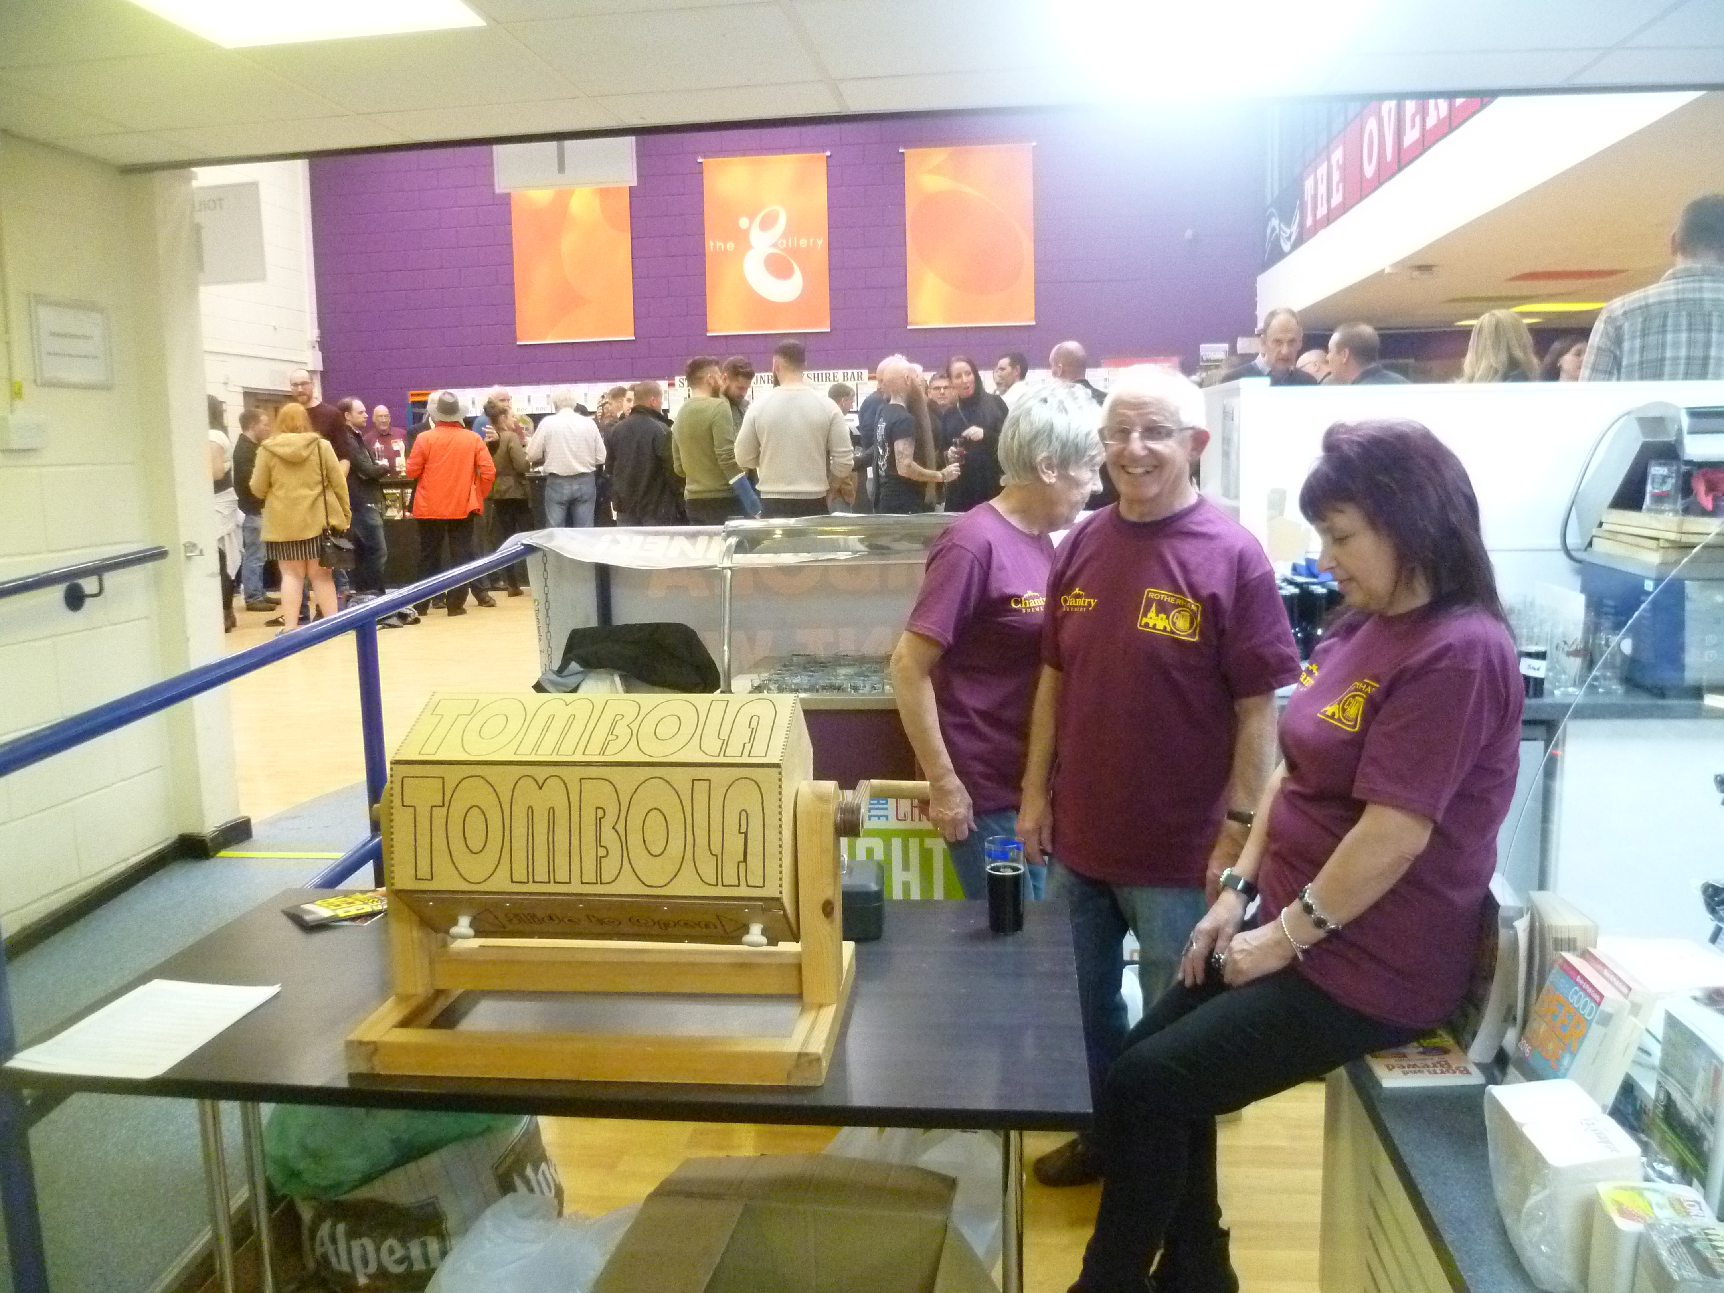
Bob Smith Rotherham
Bob was a very active member of the branch, who volunteered for a number of positions over the years and, along with his wife Sue, looked after the Tombola stall at local real ale festivals. He was always known for his friendly manner and broad smile. On the accompanying photo he is shown on the Tombola stand at the Rotherham CAMRA Festival in 2016.

Slide 27
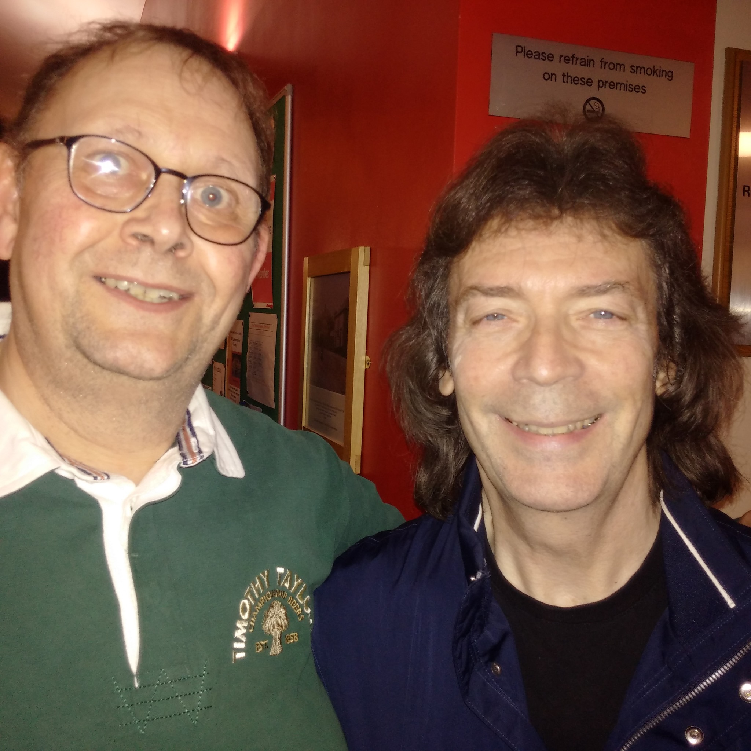
Tim Taylor Rotherham
Tim was a long time member of CAMRA, who always used to delight in telling people that a certain brewery in Keighley was named after him! Sadly, illness curtailed his activities in recent times. Besides real ale, his other big passion was live music and he would travel long distances for both. The accompanying photo shows him meeting one of his musical heroes, Steve Hackett.

Slide 28
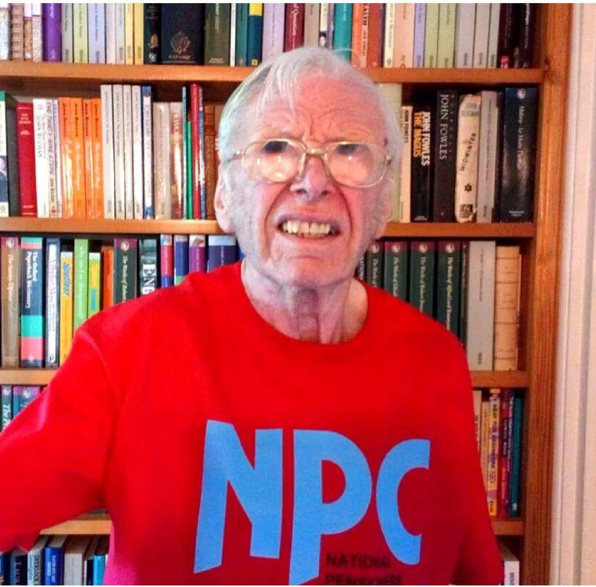
John Mackie Oxford
A familiar figure in Oxford CAMRA circles until a few years ago, John Mackie died on June 27 aged 85. Scotsman John was a civil servant for HM Customs & Excise, working in various parts of the country on VAT issues which brought him into contact with a wide range of people. When he moved to Oxford in the 1980s he became a member of CAMRA here and was often seen at social events and branch meetings and was a regular volunteer at the Oxford Beer Festival until it became too much for him.
He was particularly keen on campaigning issues, encouraging the branch to reward pubs, breweries, and individuals who had done something special. He was involved with the Campaigner of the Year award nationally and took his beer tasting seriously. A committed Socialist, John’s other great interest in later life was the Oxfordshire Branch of the National Pensioners Convention (NPC), campaigning on issues affecting retired people nationally and locally.

Slide 29
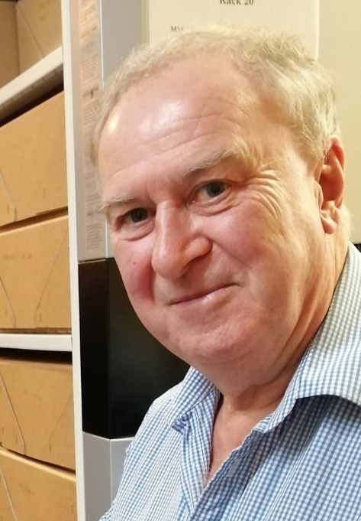
Tony Millns - Cambridge
Tony Millns was CAMRA’s National Chairman between 1982 and 1985. His impact and influence on CAMRA has been continuous during his lifetime.
Tony was born in Doncaster in 1951. For anyone who met him, his intellectual prowess was indisputable so it is probably no surprise to hear that he left Yorkshire to go to Merton College Oxford and then taught Anglo-Saxon literature at Cambridge.
Tony joined CAMRA’s National Executive in 1980 and very soon started to influence the Campaign nationally. At this time, the membership system was run using metal plates and ink! Tony worked with Pat O’Neill, an NE member who worked for IBM, to introduce a computerised membership system, which was ahead of the time. But investments like this didn’t come cheap and CAMRA was not on a good financial footing with the membership costs being more than the subscriptions and membership was declining. But there was no reduction in the need for campaigning funds so a perfect storm was brewing. Tony became CAMRA Chairman in 1982 with a clear vision to put CAMRA onto a more professional and fiscally stable platform and took steps to build a team around him that did exactly that. By the time Jim Scanlon took over from him as Chairman, CAMRA was in a much better situation.
Latterly, Tony was the driver in setting up an archive with the University of Warwick to preserve key material relating to CAMRA’s formation and history over its first 50 years and onwards. And the last piece of work Tony was involved in was as Chair of the Regions Review, which he had to stand down from due to ill health.
To quote Paul Carter, who was Tony's Vice Chair for a while, "He was in a league of his own".
Our thoughts are with Jill, his wife of many years.

Slide 30
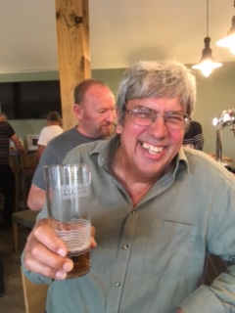
George Cottam Huntingdonshire
George was a founder member of the branch in 1974, and our first Chairman. He continued to support the branch throughout the years, including helping us to organise our 50th anniversary celebrations, which sadly turned out to be a celebration of his life.
When the local Round Table in St Neots approached the branch in 1975 and asked them to run a beer tent at the local Riverside Festival, he rose to the challenge and set about organising the first CAMRA beer festival in St Neots, and probably the first under canvas, by CAMRA. A huge task, as this had never been done before.

Slide 31
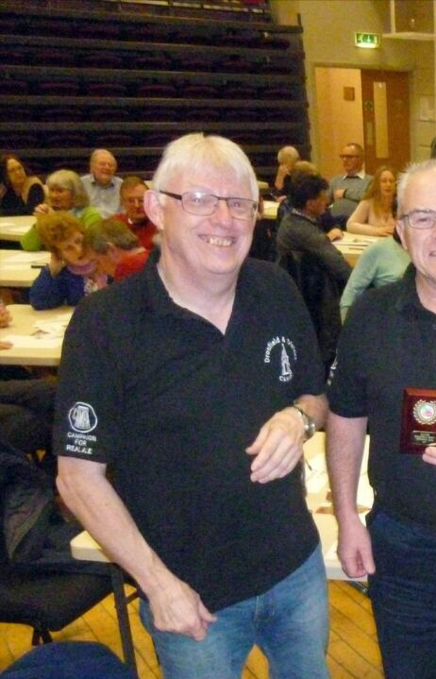
Graham Hall Dronfield and District
Graham was, for several years, Secretary of Dronfield & District Branch of CAMRA. He carried out the secretarial duties to perfection and at the same time was able to add the jobs of Social Secretary, Branch Contact and LocAle representative. He attended virtually all club activities, including getting to several Regional Meetings.
He left Dronfield, to be nearer family, during the time of Covid. He was an excellent member of our Branch Quiz Team. He is sorely missed but we all have fond memories of him.

Slide 32
Stephen Horan Glasgow and West of Scotland
Stephen was a long-time and valued member of our branch and committee. He regularly attended and contributed to branch meetings, was a valued volunteer at the Glasgow Real Ale Festival and was part of the small team who organised the festival. He was particularly partial to Brass Castle Hazelnut Mild and keen for us to stock it at the festival so we could all discover it.
Stephen lived in Helensburgh and was an architect by profession: one of his lasting legacies is a bridge he helped design, affording spectacular views of a waterfall on the Three Lochs Way near Arrochar. He left us suddenly on 16 July 2024 and is sadly missed.

Slide 33
Marcus Stanley Portsmouth and South East Hampshire
Marcus is sorely missed by his family and friends, he was a stalwart, solid and reliable, you always knew where you were with him, whether you needed help, someone to talk to or just to share a pint. He was a big man with a dry sense of humour, very knowledgeable on many subjects, including an encyclopedic knowledge of medical conditions, who had led an interesting and varied life, which was cruelly cut short all too early.
He was a long-standing member of the branch, being a life member of CAMRA. For a number of years he was also the Regional Director for the Wessex & Channel Islands region.

Slide 34
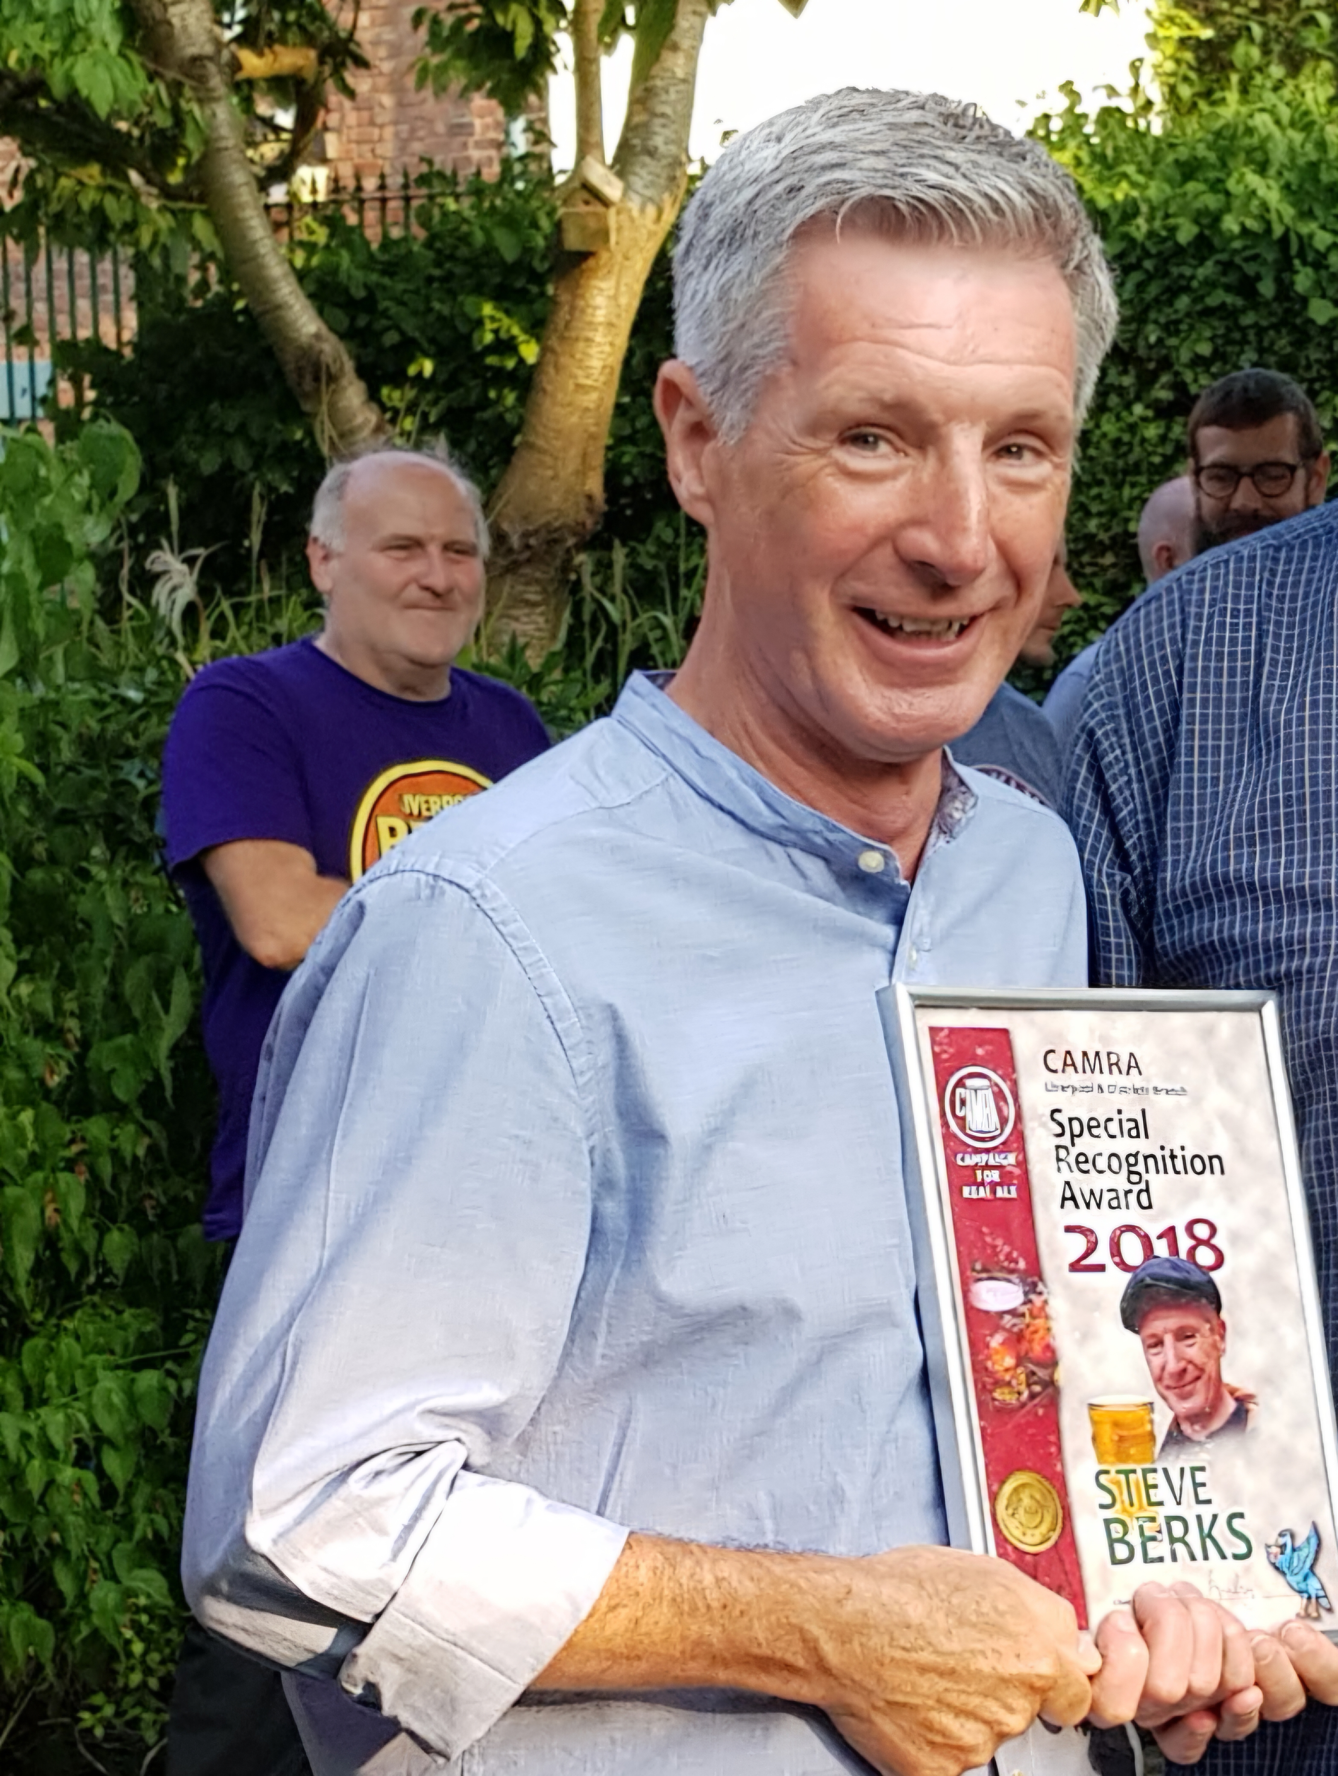
Steve Berks Liverpool and District
Steve Berks was the Cider Officer for Liverpool CAMRA until he was forced to step down following his cancer diagnosis and treatment in 2018.
He ran the cider bar at the Liverpool Beer Festival in the crypt for over 22 years, choosing, ordering, and running the bar. Due to his skill there was always a very good range of dry, medium and sweet ciders and perries right up to the closing bell and yet very little waste. The cider bar became more and more popular every year. Steve never ever got flustered, just ran everything smoothly with a little grin.
He campaigned to promote cider in more pubs, wrote articles for Mersey Ale, organised coach trips to cider-making areas and surveyed pubs in his area of Smithdown/Woolton for the branch. Steve ran cider tastings at the Hope Street Festival and also at the Augustus John, the Crown, the Everyman Bistro, and the Belvedere.
He was also Regional Cider Coordinator for Merseyside and Cheshire. In 2018 Steve Berks was awarded the Branches Special Recognition Award for his contribution towards Cider and Perry.
Although he had a long battle against cancer, he still often popped out for a pint. Our thoughts go out to his family and friends.

Slide 35
David Adams Portsmouth and South East Hampshire
David was for many years a key member of the branch. He had served as one of our auditors (at which he was very meticulous), running the games stand at our beer festivals, Pubs Officer and Brewery Liaison Officer for Newtown and Powder Monkey breweries.
He was a regular contributor to our branch magazine, Ale Mail, providing much information about pubs in the western area of our branch. Outside of CAMRA, he was a keen campanologist, being one of the ringers at St. Marys Church in Alverstoke.

Slide 36
Richard Hambridge Portsmouth and South East Hampshire
Dickie, as he was known, was an active branch member for many years. He served as Brewery Liaison Officer for Irving Brewery from its opening to closure. He then took on the position of BLO for our two Brewhouse & Kitchen brewpubs. Outside of CAMRA, he was heavily involved with the local Morris side (Victory Morris) as one of their musicians, at which he was very skilled.

Slide 37
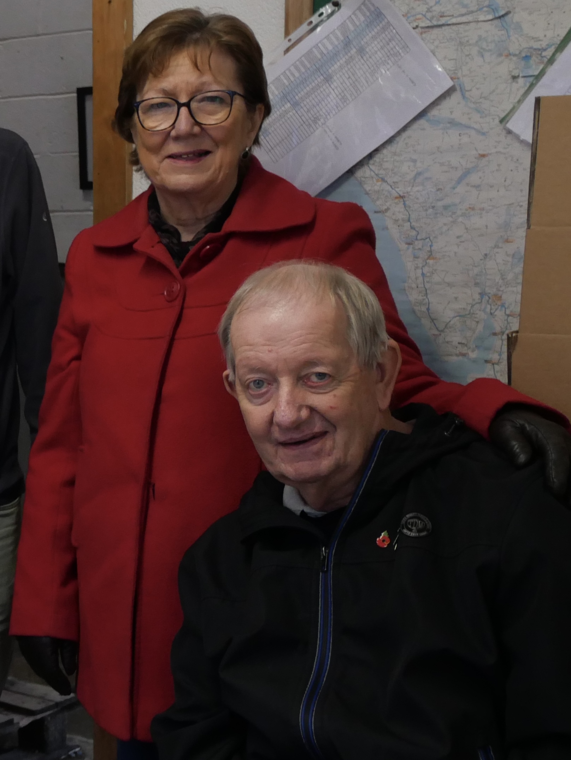
Dave Latham Furness
David Edward Latham, or as he was known to everybody “Dave Latham” passed away peacefully on 5th July 2024 aged 73, far too young.
He never fully recovered from sustaining a stroke at home while celebrating his 70th birthday.
He was married to Pamela and with two sons, each from their earlier marriages, Dave and Pamela had a long and loving marriage together.
Dave worked as a mechanic maintaining the machines at Askam K shoes factory before moving to Glaxo in Ulverston for a number of years until he took early retirement.
Dave was Brewery Liaison Officer for Foxfield, Coniston and Cumbrian Legendary Ales (now Cumbrian Ales) breweries over the years and he was a major volunteer at Ulverston Beer Festivals. He was also a volunteer NHS driver and a Meals-on-wheels deliver driver.
As you would expect, Dave was a great supporter of real/live ale and was heavily involved in the Furness Branch as Secretary.
He is sorely missed by his wife, Pam and of course by his fellow Branch Members.

Slide 38
Andy Beaton Wolverhampton
Since the 1970s, Andy was a very big part of Wolverhampton branch, and CAMRA as a whole.
His involvement extended to all levels, from former branch Chairman, to serving as Regional Organiser for the West Midlands and several years on CAMRA's National Executive along with volunteering his extensive expertise at many a beer festival including with organizing the GBBF.
Respected and remembered as great company and lovely chap by all who met him over the course of his CAMRA journey. In more recent years he played a key role on the Wolverhampton Beer Festival committee which is how Mark Hewitt, the current branch chairman, met him.
Mark will miss him as the friend he used to chat with on the bus to and from beer festival meetings.

Slide 39
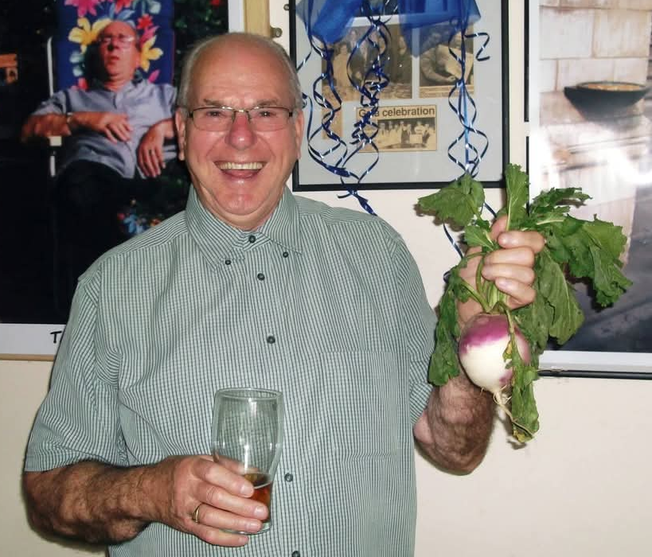
Bill Bardsley Trafford and Hulme
Bill was a founder member of CAMRA joining whilst living in Redditch with his wife Jackie and only child, Alison. He moved to Manchester to be nearer his daughter with his wife Jackie in 2005 and became a much loved and respected member of Trafford & Hulme branch. Bill was a gentle man with a huge sense of humour. He loved to visit Germany and drink anything German.
He also loved his allotment and when he couldn't do that for himself, he became the branch members who have an allotments valued consultant. He leaves his wife of 63 years, Jackie and his daughter Alison and husband, Russ.
Jackie is still a valued CAMRA member and enjoys her day out with the Greater Manchester CAMRA ladies.
Bill with a turnip grown by another branch member

Slide 40
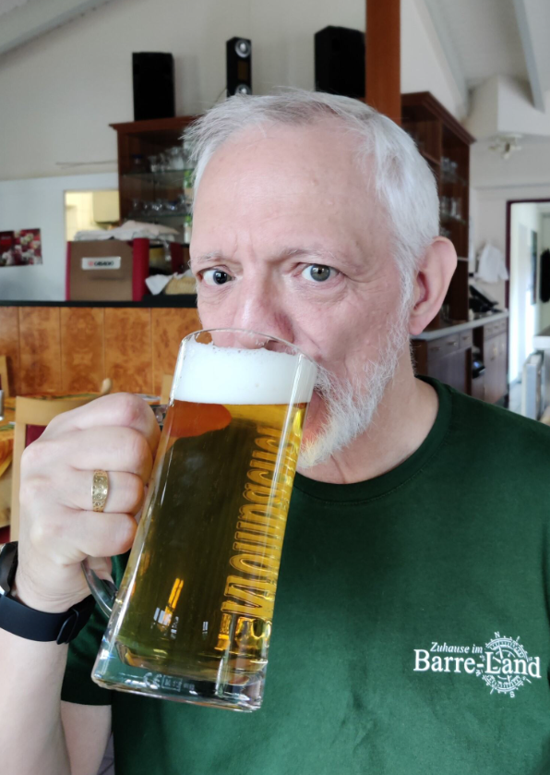
Bryan Betts Richmond and Hounslow
Bryan was universally liked and admired for his great talents, achievements and loving, kind and generous personality. He died very unexpectedly and suddenly of cancer in February 2024 at age 61. He was born in 1962 and spent his happy early years exploring the woods and fields around Weston-Super-Mare with his younger sister Jacqui.
A bright boy, he gained a place at Warwick University and graduated with a degree in Electronic Engineering. He became a journalist and wrote for many publications, including Computer Weekly, The Register and national newspapers. For a time, he worked in Hanover for Cebit the Computer fair. Among his hobbies were Viking re-enactment events and at such an event in Oerlinghausen in 2000, he met Helma, his future wife. She joined him in Brentford in 2001 and they married in 2009. Son Roric came in 2010 and daughter Elfie in 2013.
Bryan appreciated real ale at an early age and was always on the lookout for new craft beers to try. He became a beer expert (#BeerViking) writing about beer in national magazines and websites.
CAMRA's Christine Cryne said: “Bryan and Helma joined the London Tasting Panel many years ago. Although Helma stood down when she became pregnant, Bryan continued and was a very active member, contributing many, many beer assessments, and descriptions for the Good Beer Guide each year. Bryan also qualified as a CAMRA Beer Judge and employed his expertise on both CAMRA’s Champion Beer of Britain judging panels and others, such as the World Beer Awards. He became a very good judging panel chair and used this skill at CAMRA’s first Home Brew Competition and, more recently, at CAMRA’s Champion Beer of London. I, and all the London Tasting Panel, will miss him, his great palate and beer knowledge”.
Bryan often arrived at the local CAMRA Richmond and Hounslow branch meetings on his bike, a manifestation of his commitment to environmental issues. All at the branch were deeply shocked by this much loved and loving family man’s passing and send heartfelt condolences to his family on their tragic loss.

